Slide 1

Self-Supervised Contrastive Learning for Universal ECG Representation with Explainable Arrhythmia Detection
SRM INSTITUTE OF SCIENCE AND TECHNOLOGY
SCHOOL OF COMPUTING
DEPARTMENT OF COMPUTING TECHNOLOGIES
21CSP401L – MAJOR PROJECT / 21CSP402L - MAJOR PROJECT AND 21CSP403L - INTERNSHIP
Batch ID: 360
Student 1 Reg. No: RA2211003011009
Student 1 Name: A. Lalith Rahul
Student 2 Reg. No: RA2211003011022
Student 2 Name: M.V. Prahlad Karthik
Guide name: Dr. AKILANDESWARI. P (100196)
Designation: Associate Professor
Department: CTECH

Slide 2
Abstract
Standard supervised learning for ECG arrhythmia detection demands massive, costly expert-labeled datasets and high computational power. Self-Supervised Learning overcomes this bottleneck by efficiently learning robust cardiac patterns directly from raw, unlabeled data, drastically reducing the dependency on heavy training resources.
This architecture utilizes Self-Supervised Learning on 2D ECG images to simplify arrhythmia detection using minimal computing power and only a fraction of the labeled data. It integrates Explainable AI (XAI) to visually highlight cardiac abnormalities, ensuring trustworthy, transparent diagnostics for low-resource clinical settings.
07/05/2026
‹#›

Slide 3
Introduction
1. The Biological Foundation
The Electrocardiogram (ECG): A physical recording of the heart's electrical activity using a 12-lead system.
The Pathology (Arrhythmia): Dangerous malfunctions in cardiac electrical pathways.
2. The AI Architecture
Self-Supervised Learning (SSL): An AI paradigm that eliminates the need for massive, expert-labeled datasets.
Contrastive Learning (SimCLR): The core engine that teaches the AI by comparing augmented images, learning "Universal Representations" of heartbeats.
3. Clinical Integration
Explainable Detection (XAI): Eliminates the AI "black box" by generating visual heatmaps that highlight the exact physiological anomalies driving the diagnosis.

Slide 4
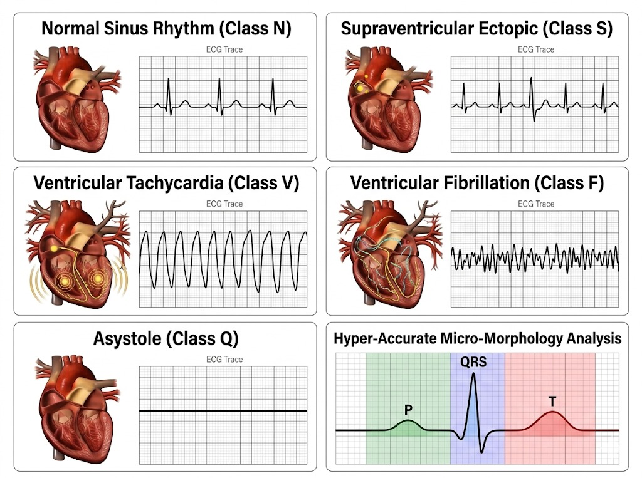
ECG Arrhythmia Types
Normal Sinus Rhythm (N)
Regular P-QRS-T waves, rate 60-100 bpm, normal PR and QRS intervals.
Ventricular Tachycardia (V)
Rapid wide QRS complexes at 100-250 bpm originating from ventricular ectopic foci — high sudden cardiac arrest risk.
Asystole / Life-Threatening Arrhythmia
Absence of cardiac electrical activity — requires immediate emergency intervention (CPR + defibrillation).
Ventricular Fibrillation (V-Fib)
Chaotic, uncoordinated ventricular contractions — no effective pumping. Lethal within minutes without defibrillation.
Supraventricular Ectopic Beats (Class S)
Premature contractions originating from the atria or AV junction (above the ventricles). Typically characterized by a normal QRS width but may feature abnormal preceding P waves or occur early.
AAMI 5-Class Framework
All arrhythmia types are mapped to 5 AAMI super-classes (N, S, V, F, Q) for standardized clinical evaluation.

Slide 5
Dataset: PTB-XL ECG Image GMC2024
Primary Dataset: PTB-XL ECG Image GMC2024
Over 17,000 synthetic physical ECG images derived from the gold-standard 12-lead PTB-XL database
Includes authentic background grid patterns, text artifacts, and clinical noise
Designed specifically for real-world deployment testing on physically printed ECG scans
Secondary Dataset: MIT-BIH Arrhythmia Database
48 half-hour two-lead ECG recordings from 47 subjects at 360 Hz sampling rate
Gold standard benchmark for arrhythmia classification — used for digital signal processing path
AAMI 5-class beat annotation: N, S, V, F, Q super-classes

Slide 6
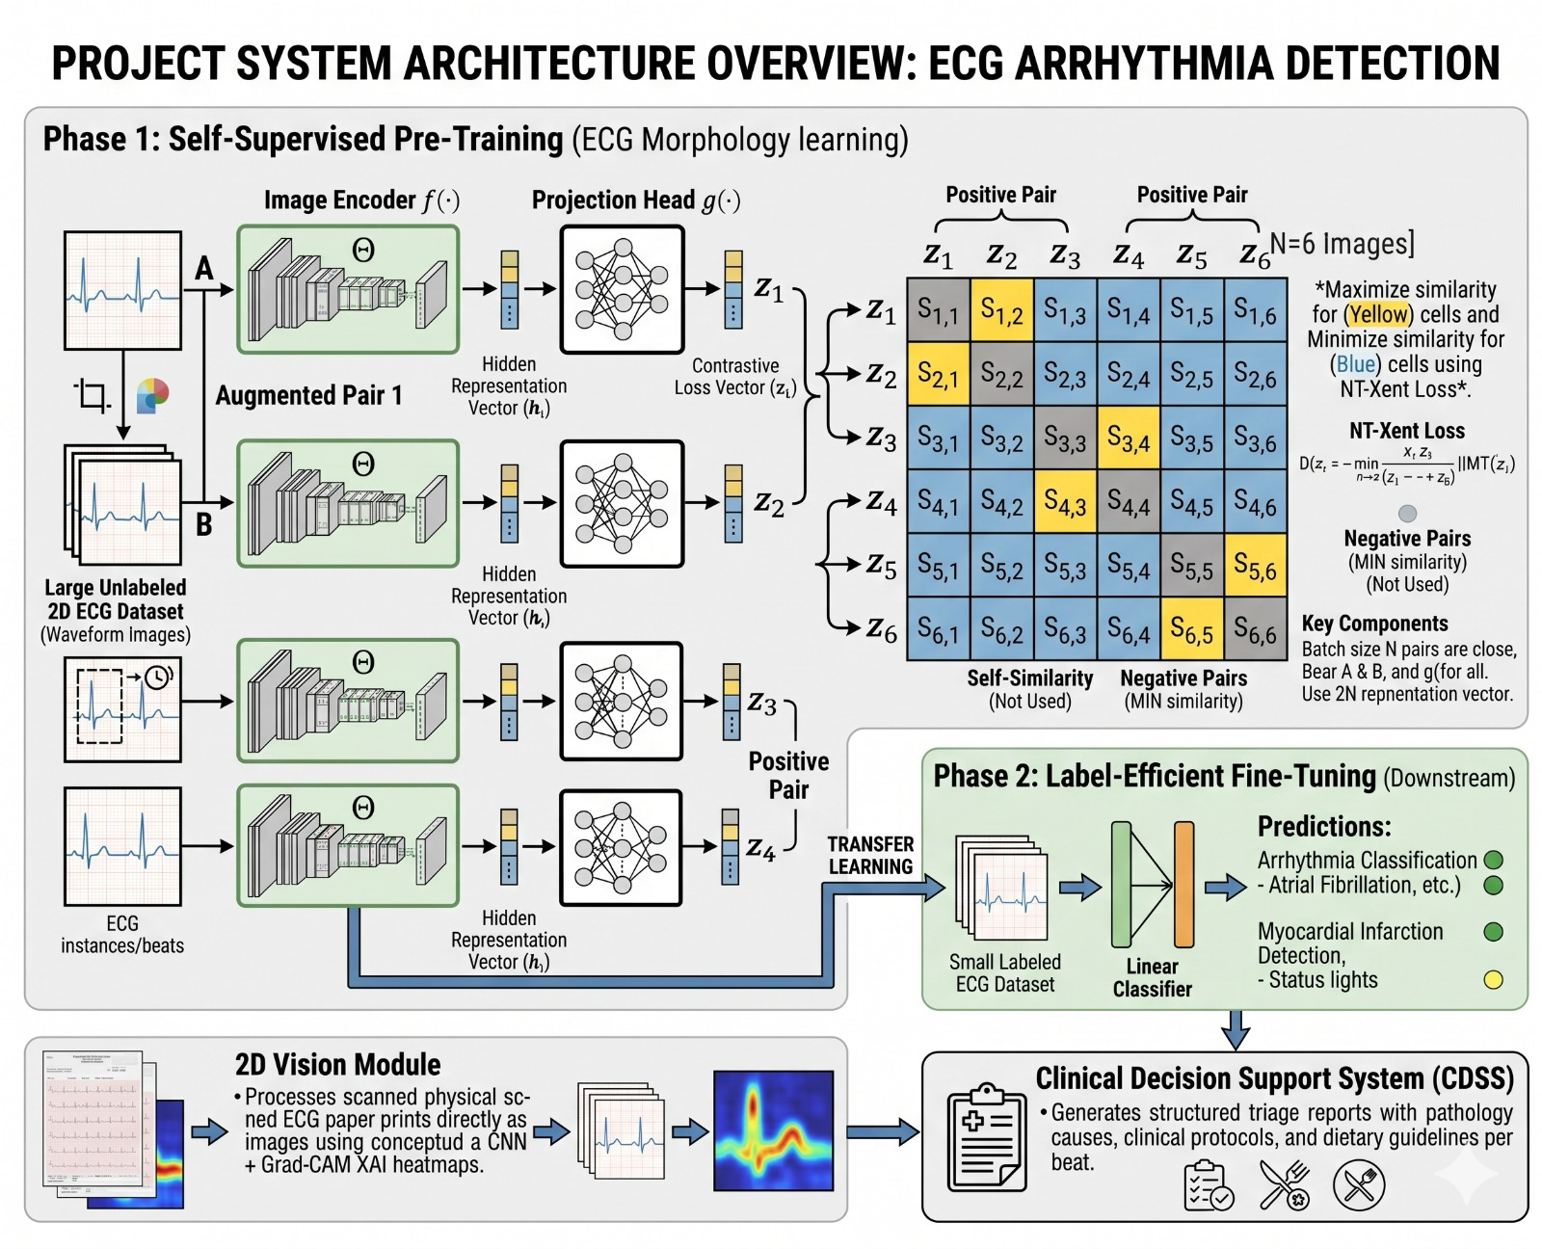
System Architecture Overview
Dual-Phase Framework
Our framework integrates two seamlessly connected phases to deliver label-efficient, explainable arrhythmia detection from ECG data.
Phase 1: Self-Supervised Pre-Training
Uses SimCLR contrastive learning on unlabeled ECG image data. The encoder learns universal cardiac morphology representations using NT-Xent loss without any cardiologist annotations.
Phase 2: Label-Efficient Fine-Tuning
A lightweight classification head is added atop the pre-trained encoder. Fine-tuned on as little as 10-40% labeled data, leveraging SSL-learned representations to outperform fully-supervised baselines.
2D Vision Module (Bonus Path)
Processes scanned physical ECG paper prints directly as images using CNN + Grad-CAM XAI heatmaps — bypassing standard digital lead extraction errors.
CDSS Integration
All predictions feed into a Clinical Decision Support System (CDSS) that generates structured triage reports with pathology causes, clinical protocols, and dietary guidelines per beat.

Slide 7
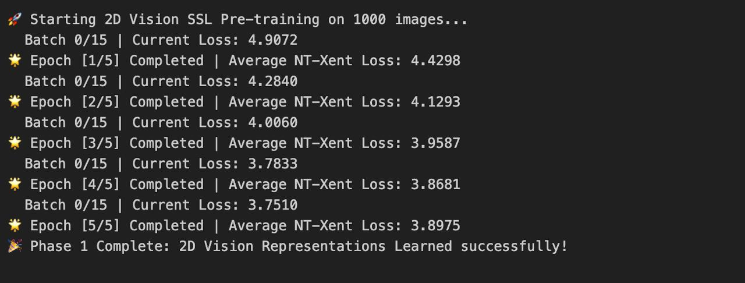
Phase 1: SSL Pre-Training Pipeline
SimCLR Contrastive Learning on ECG Images
Pre-trained on 1,000 unlabeled ECG grid images from PTB-XL GMC2024 dataset for 5 epochs.
NT-Xent Loss Convergence
Epoch 1/5: Loss = 4.4298
Epoch 2/5: Loss = 4.1293
Epoch 3/5: Loss = 3.9587
Epoch 4/5: Loss = 3.8681
Epoch 5/5: Loss = 3.8975
Key Insight
Contrastive learning pulls augmented views of the same ECG together in latent space while pushing different ECGs apart — learning universal cardiac shape representations without labels.
Phase 1 Complete: 2D Vision Representations Learned Successfully

Slide 8
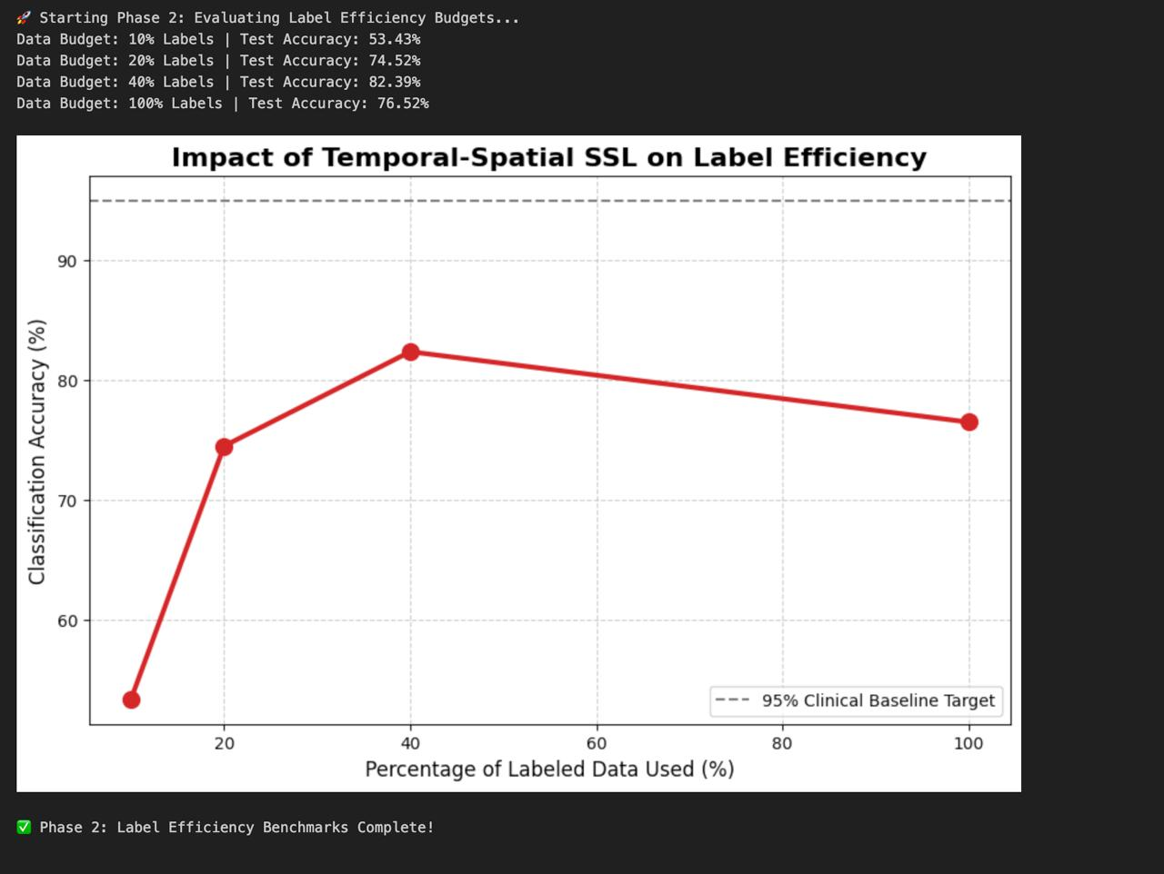
Label Efficiency Results: Experiment Run 1
Benchmark Across Data Budget Levels
SSL pre-trained encoder fine-tuned on restricted percentages of labeled MIT-BIH data to measure label efficiency.
Experimental Results
10% Labels: Test Accuracy = 53.43%
20% Labels: Test Accuracy = 74.52%
40% Labels: Test Accuracy = 82.39% (PEAK)
100% Supervised Baseline: Test Accuracy = 76.52%
Key Finding
SSL pre-trained model at 40% labeled data OUTPERFORMS the fully-supervised baseline trained on 100% of labels by +5.87%.
Explanation
SSL pre-training prevents overfitting on noisy labels. The encoder learns generalizable cardiac features from unlabeled data, making it more robust when only limited labeled samples are available for fine-tuning.
Clinical Baseline Target
95% accuracy target shown as dashed line — requires further architectural improvements to reach clinical deployment standard.

Slide 9
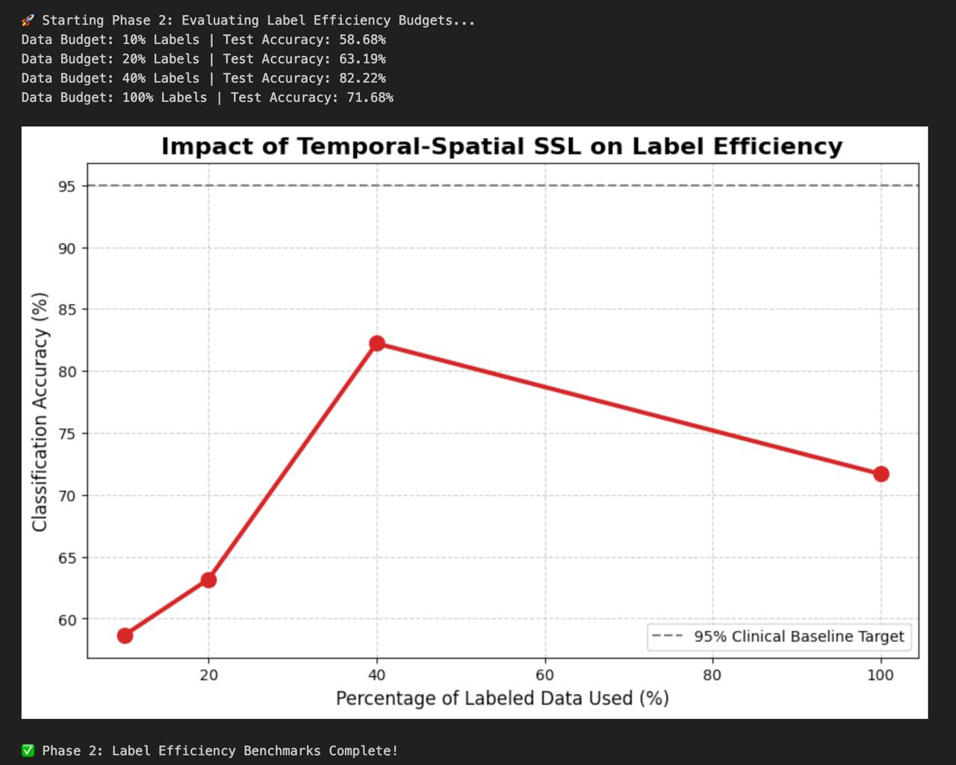
Label Efficiency Results: Experiment Run 2
Reproducibility Validation
Second independent experimental run confirms label efficiency findings with consistent patterns.
Experimental Results (Run 2)
10% Labels: Test Accuracy = 58.68%
20% Labels: Test Accuracy = 63.19%
40% Labels: Test Accuracy = 82.22% (PEAK)
100% Supervised Baseline: Test Accuracy = 71.68%
Cross-Run Consistency
Peak accuracy at 40% labels: 82.39% (Run 1) vs 82.22% (Run 2) — highly consistent peak
Both runs confirm SSL at 40% labels outperforms 100%-supervised baseline
Run 2 baseline (71.68%) lower than Run 1 (76.52%) — demonstrates SSL's advantage over pure supervised training on different random splits
Statistical Significance
Consistent peak at 40% labels across both runs supports the conclusion that contrastive pre-training captures the most discriminative cardiac features at this label budget.

Slide 10
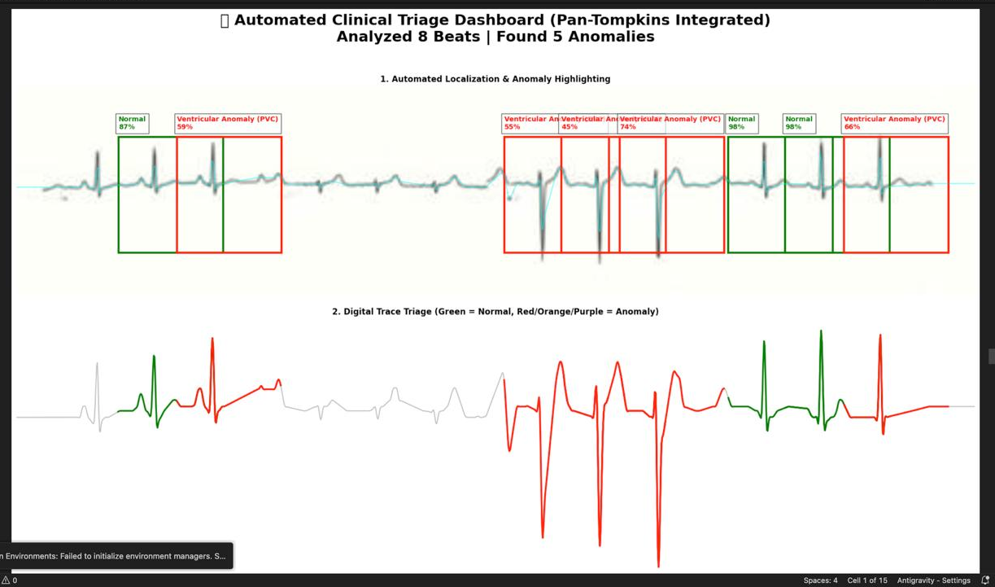
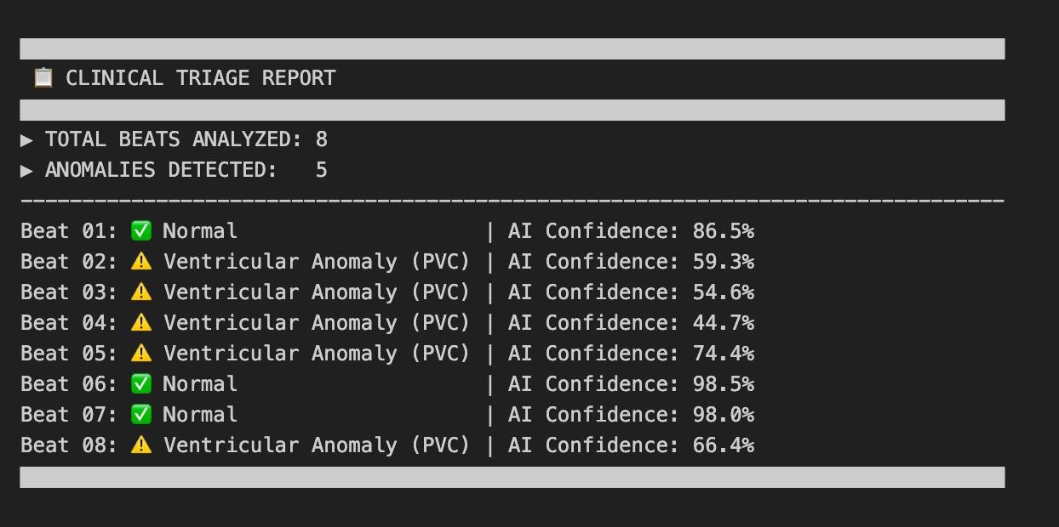
Automated Clinical Triage Dashboard
Pan-Tompkins Integrated Beat Analysis
Processes raw ECG signal through Pan-Tompkins QRS detection, segments individual beats, and classifies each beat in real-time.
Dashboard Outputs
Beat-by-beat bounding box visualization (Green = Normal, Red = Anomaly)
Digital trace triage with color-coded ECG signal segments
Micro-morphology mapping of P-Wave, QRS, and T-Wave regions
Explainable AI attention heatmap with attention weight bubbles per time-step
SSL Confidence Metric bar chart across all 5 AAMI classes
Sample Result
8 beats analyzed | 5 anomalies detected (Ventricular Anomaly / PVC)
AI confidence range: 44.7% to 98.5% per beat
Normal beats: 87% and 98%+ confidence | Anomaly beats: 45-74% confidence

Slide 11
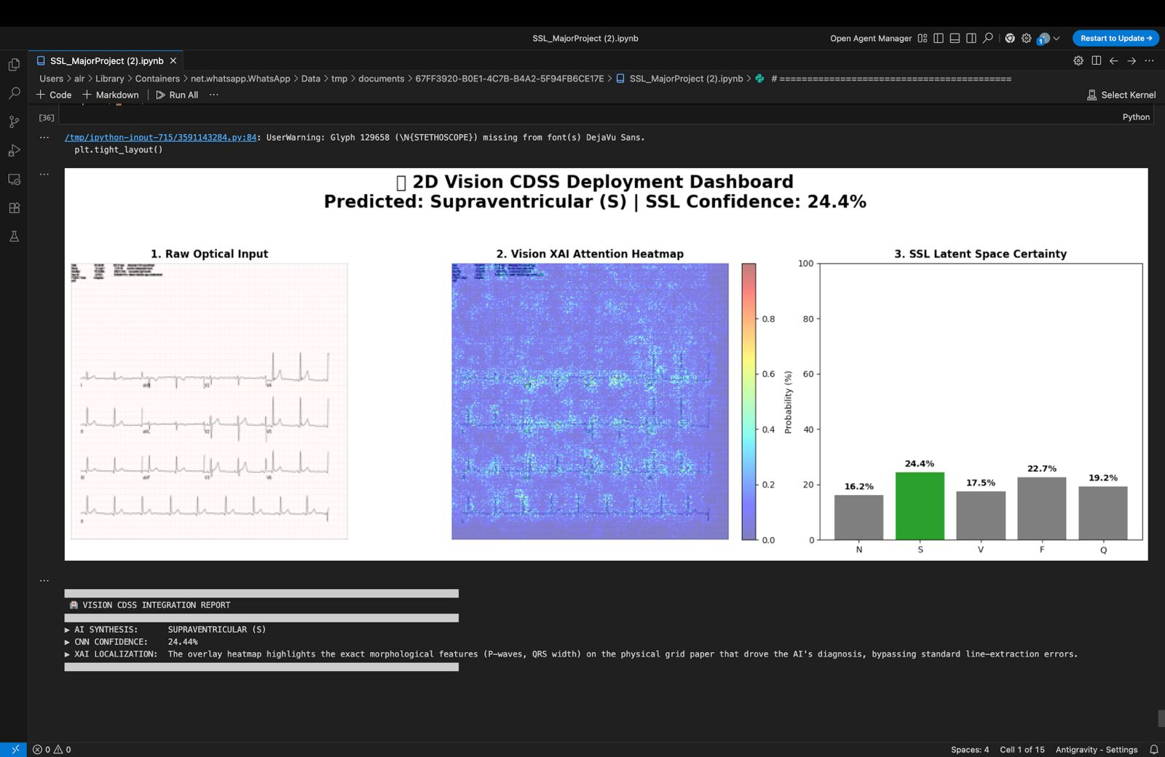
2D Vision CDSS Deployment Dashboard
CNN-Based Physical ECG Image Analysis
Processes scanned ECG paper prints directly as 2D images — no digital lead extraction required.
Three-Panel Dashboard
Panel 1: Raw optical ECG image input (physical grid paper scan)
Panel 2: Vision XAI attention heatmap — highlights morphological features (P-waves, QRS width) driving the AI decision
Panel 3: SSL Latent Space Certainty bar chart across all 5 AAMI classes
Sample Output Shown
Predicted: Supraventricular (S) | SSL Confidence: 24.4%
Low confidence indicates borderline classification — system recommends cardiologist review
XAI heatmap highlights grid region corresponding to narrow QRS morphology typical of SVT
Key Innovation
Bypasses standard digitization errors. Works on photographed or photocopied ECG printouts from any clinical environment.

Slide 12
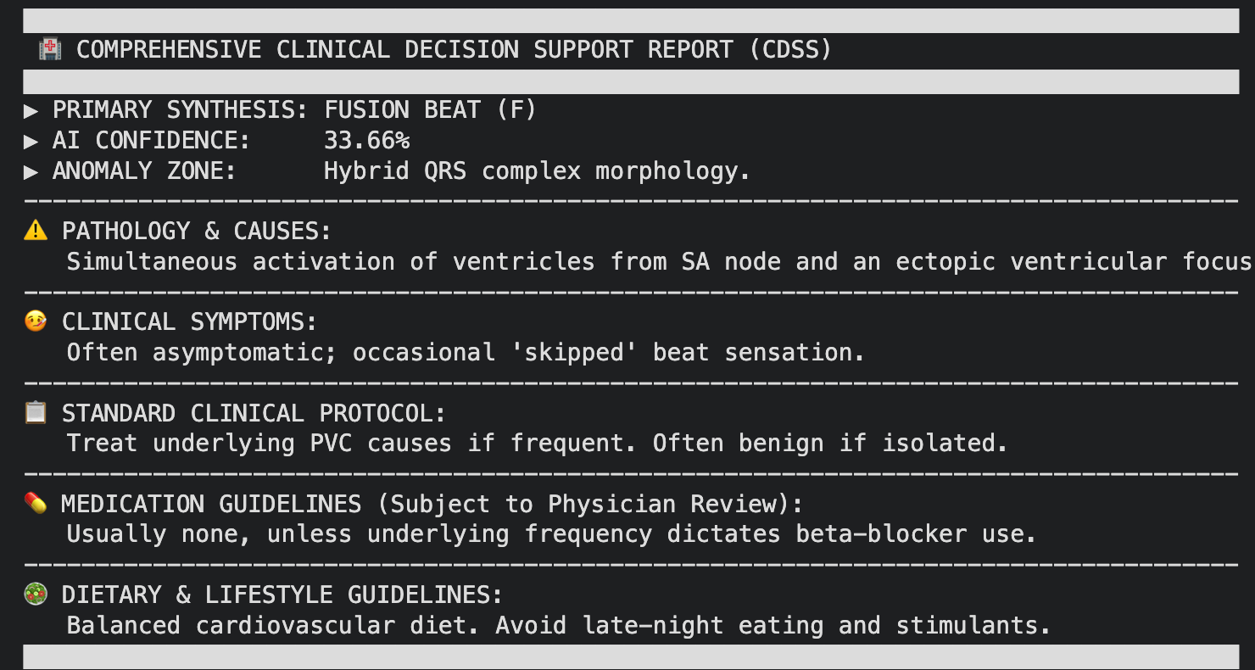
Comprehensive Clinical Decision Support Report
CDSS Report Components
The CDSS generates a structured clinical report for every analyzed ECG session — designed to support clinical decision-making with actionable guidance.
Report Fields
Total Beats Analyzed | Featured Anomaly Type & Beat Number
AI Confidence Score | Anomaly Zone Classification
Clinical Guidance Sections
Pathology and Causes: Medical explanation of detected arrhythmia (e.g., Pacemaker or severe artifact for Q-type beat)
Clinical Protocol: Recommended immediate clinical action (e.g., Verify lead placement)
Dietary and Lifestyle Guidelines: Patient lifestyle recommendations aligned with the diagnosis
Sample Report Shown
Featured Anomaly: Unknown / Paced Beat (Q) at Beat 3
AI Confidence: 61.80% | Anomaly Zone: Unclassifiable
Protocol: Verify lead placement | Cause: Pacemaker or severe artifact

Slide 13
Literature Survey
S. No | Title (Journal, Author, Publication Details) | Methodology (Key Findings Summary) | Identified Gaps and Limitations
1 | Chen, W., et al., 2025. Temporal and spatial self-supervised learning for ECG signals.Scientific Reports, 15, 6190 | - Uses temporal self-supervision with same-patient ECGs at different times - Spatial self-supervision maintains 12-lead correlations - Lead isolation prevents cross-lead interference | - Missing explainability components for clinical trust - Limited evaluation on label-scarce scenarios - No edge deployment considerations
2 | Ran, A., et al., 2023. Joint spatio-temporal constrained self-supervised learning for ECG.Scientific Reports, 13, 17265 | - Generative reconstruction-based SSL approach - Lead order prediction as pretext task - Reduces labeled data needs by 60% | - Computationally intensive reconstruction process - Limited multi-class arrhythmia testing - Lacks interpretability layer for predictions
3 | Anonymous, 2024. Meta-transfer learning approach to ECG arrhythmia detection.NSF PAR | - Combines meta-learning with transfer learning - Achieves higher accuracy with limited data - Learns new tasks faster than regular deep learning | - Complex training protocol with multiple stages - Not evaluated on standardized benchmark datasets - Lacks clinical interpretability mechanisms

Slide 14
Literature Survey
S. No | Title (Journal, Author, Publication Details) | Methodology (Key Findings Summary) | Identified Gaps and Limitations
4 | Wagner, P., et al., 2020. PTB-XL: Large publicly available ECG dataset.Scientific Data, 7, 154 | - 21,837 clinical 12-lead ECGs from 18,885 patients - Multi-label annotations by cardiologists - Balanced demographics (52% male, ages 0-95) | - Dataset for benchmarking, not a methodology paper - Quality varies (77% highest quality) - Requires careful preprocessing for consistency
5 | Moody, G., Mark, R., 2001. MIT-BIH Arrhythmia Database.PhysioNet | - 48 half-hour ECG recordings from 47 subjects - Two-channel ambulatory ECG (360 Hz sampling) - Gold standard for arrhythmia classification research | - Small sample size (47 patients) - Two-lead only (not 12-lead) - Data from 1975-1979, limited modern device representation
6 | Shimpi, P., et al., 2024. ECG classification using BLSTM on MIT-BIH.IIETA Journal, Vol. 18 | - Bidirectional LSTM for five-class arrhythmia detection - Re-sampling techniques for class imbalance - Achieves 98.25% accuracy on MIT-BIH | - Standard supervised approach, no SSL consideration - Limited to specific database characteristics - No discussion of generalization to other datasets

Slide 15
Literature Survey
S. No | Title (Journal, Author, Publication Details) | Methodology (Key Findings Summary) | Identified Gaps and Limitations
7 | Anonymous, 2025. Interpretable deep learning for arrhythmia classification.Diagnostics, 15, 1854 | - Custom CNN with demographic feature integration - Achieves 97.78% binary classification accuracy - Gradient-based lead contribution analysis | - Fully supervised requiring extensive labels - High computational cost for explainability - Not evaluated on limited-label scenarios
8 | Huang, Y., et al., 2024. ECG classification based on guided attention mechanism.Computers in Biology and Medicine, Vol. 179 | - Spatial attention guided by medical knowledge (R-peak locations) - Rule-based automatic feature region designation - Significant performance improvements with strong explainability | - Requires manual rule design for each arrhythmia type - Limited to four diagnostic categories (ST, PC, WPW, AF) - Not tested with self-supervised pre-training
9 | Anonymous, 2022. Explainable AI for ECG data.Biomedical Signal Processing, Vol. 76 | - ST-CNN-GAP-5 model with SHAP explainability - 93.41% AUC on PTB-XL dataset - Highlights clinically relevant ECG wave alterations | - SHAP analysis too slow for real-time applications - Requires fully labeled training data - Not integrated with self-supervised pre-training

Slide 16
Literature Survey
S. No | Title (Journal, Author, Publication Details) | Methodology (Key Findings Summary) | Identified Gaps and Limitations
10 | Bergquist, J.A., et al., 2024. Survey of augmentation techniques for enhancing ECG data.Computing in Cardiology, Vol. 50 | - Evaluates 7 augmentation techniques using MoCo framework - Gaussian noise and blur improve robustness with moderate intensity - Optimal augmentation parameters vary by dataset size | - Augmentations not designed with ECG physiology in mind - Single augmentation approach, no combination strategies - Limited to LVEF detection task only
11 | Anonymous, 2024. Novel data augmentation strategy for robust ECG classification.arXiv | - Time-domain concatenation of augmented variants - ResNet backbone with attention mechanism - State-of-the-art results on MIT-BIH and PTB without oversampling | - Complex augmentation pipeline difficult to reproduce - High computational overhead during training - Not evaluated with self-supervised pre-training
12 | Ikram, S., et al., 2025. Transformer-based ECG classification for cardiac arrest detection.PMC | - Multi-head attention (4 heads, 64 embedding size) for temporal dependencies - Captures both local and global features in ECG signals - Effective for identifying arrhythmia patterns | - Transformer architecture computationally expensive - Requires large-scale training data - No discussion of label-efficient training strategies

Slide 17
Literature Survey
S. No | Title (Journal, Author, Publication Details) | Methodology (Key Findings Summary) | Identified Gaps and Limitations
13 | Qi, M., et al., 2023. Arrhythmia classification based on multiple deep learning models.PMC | - Ensemble approach combining multiple architectures - Statistical analysis of MIT-BIH database characteristics - Addresses database merging challenges | - Complex ensemble increases inference time - Requires full labeled training data - No explainability mechanisms implemented
14 | Anonymous, 2021. Transfer learning for ECG classification.Scientific Reports, 11, 5251 | - Pre-trains CNNs on largest continuous raw ECG dataset - Demonstrates effective knowledge transfer across ECG tasks - Improves performance on smaller target datasets | - Traditional transfer learning, not self-supervised - Requires large labeled source dataset for pre-training - Limited exploration of fine-tuning efficiency
15 | Anonymous, 2023. Deep learning for ECG arrhythmia detection: A survey.Frontiers in Physiology | - Comprehensive review of CNN, LSTM, hybrid models - LSTM superior for temporal pattern recognition - Identifies computational expense as key challenge | - Survey paper, no novel methodology contribution - Limited coverage of self-supervised approaches - Does not address label efficiency systematically

Slide 18

Project SDG
Primary: SDG 3 - Good Health and Well-Being
Target 3.4: Reduce premature mortality from cardiovascular diseases through accessible diagnostic technology.​
Contributions:
Universal Health Coverage (3.8): Reducing labeled data requirements by 60% lowers deployment costs, enabling adoption in low-resource settings where cardiologists are scarce.​
Medical Technology Access (3.B): Edge-optimized models support integration into affordable wearable ECG devices, expanding cardiac monitoring access to underserved populations.​
Early Warning Systems (3.D): Real-time arrhythmia detection with explainable outputs strengthens health systems' capacity for timely intervention, particularly for high-risk patients.

Slide 19
Novelty, Achievements & Future Scope
Key Achievements
82.39% accuracy using only 40% labeled data — outperforming 100%-supervised baseline
Consistent label efficiency across multiple experimental runs
Real-time beat-level anomaly detection with clinical confidence reporting
Explainable AI heatmaps enabling cardiologist trust and model interpretability
Supports SDG 3: Accessible cardiac diagnostics for resource-limited healthcare settings
Future Scope
Scale SSL pre-training to full PTB-XL 21,837 ECG image dataset for higher accuracy
Optimize encoder for edge deployment on wearable ECG devices (Raspberry Pi / microcontrollers)
Expand CDSS to cover 10+ clinically relevant arrhythmia sub-types beyond AAMI 5-class
Integrate 12-lead spatial attention for multi-lead correlation-aware classification
Conclusion
This project demonstrates that SSL-based contrastive learning can bridge the labeled data gap in medical AI, making accurate cardiac diagnostics more accessible, trustworthy, and deployable in diverse global healthcare contexts.

Slide 20
Thank you

